Slide 1
Char Drivers
BHAVANA
DAY 25
08/05/2024

Slide 2
Scull: Pseudo-Device
Example char-type device driver

Slide 3
Introduction
A complete char device driver
scull
Simple Character Utility for Loading Localities
Kernel allocated memory treated as device
Not hardware dependent
Explore interface between char driver and kernel

Slide 4
The Design of scull
Implements various devices
scull0 to scull3
Four device drivers, each consisting of a memory area
Global
Data contained within the device is shared by all the file descriptors that opened it
Persistent
If the device is closed and reopened, data isn’t lost

Slide 5
The Design of scull
scullpipe0 to scullpipe3
Four FIFO devices
Act like pipes
Illustrate how blocking and non-blocking read and write can be implemented

Slide 6
The Design of scull
Variants of scull0
Illustrate typical driver-imposed access limitations
scullsingle
Similar to scull0
Only one process can use the driver at a time
scullpriv
Private to each virtual console

Slide 7
The Design of scull
One user at a time
sculluid
Can be opened multiple times by one user
Fails on open() if another user is locking the device
Returns “Device Busy”
scullwuid
Blocks on open() if another user is locking the device

Slide 8
Major and Minor Device Numbers
Identifying a Device

Slide 9
Major and Minor Device Numbers
Char devices are accessed through names in the file system
Abstraction for handling devices
Special files in /dev
Implemented using inode data structure
> cd /dev
> ls –l
crw------- 1 root root 5, 1 Apr 12 16:50 console
brw-rw---- 1 root disk 8, 0 Apr 12 16:50 sda
brw-rw---- 1 root disk 8, 1 Apr 12 16:50 sda1

Slide 10
Major and Minor Device Numbers
Char devices are accessed through names in the file system
Abstraction for handling devices
Special files in /dev
Implemented using inode data structure
> cd /dev
> ls –l
crw------- 1 root root 5, 1 Apr 12 16:50 console
brw-rw---- 1 root disk 8, 0 Apr 12 16:50 sda
brw-rw---- 1 root disk 8, 1 Apr 12 16:50 sda1
Major numbers
Block drivers are identified by a “b”
Char drivers are identified by a “c”
Minor numbers

Slide 11
Major and Minor Device Numbers
Major number traditionally identifies the device driver
Class of device (traditionally)
E.g.,
/dev/sda and /dev/sda1 are managed by driver 8
cat /proc/devices
Map number to name of device driver
Can have more than one major to a single driver but not typical
Minor number specifies the particular device

Slide 12
The Internal Representation of Device Numbers
dev_t type, defined in <linux/types.h>
Macros defined in <linux/kdev_t.h>
12 bits for the major number
Use MAJOR(dev_t dev) to obtain the major number
20 bits for the minor number
Use MINOR(dev_t dev) to obtain the minor number
Use MKDEV(int major, int minor) to turn them into a dev_t

Slide 13
Allocating and Freeing Device Numbers
Register a major device number (old way)
int register_chrdev_region(dev_t first, unsigned int count, char *name);
first
Beginning device number
Minor device number is often 0
count
Requested number of contiguous device numbers
name
Name of the device
return
0 on success, error code on failure

Slide 14
Allocating and Freeing Device Numbers
Kernel can allocate a major number on the fly (dynamic major number)
int alloc_chrdev_region(dev_t *dev, unsigned int firstminor, unsigned int count, char *name);
dev
Output-only parameter that holds the first number on success
firstminor
Requested first minor number
Often 0

Slide 15
Allocating and Freeing Device Numbers
To free your device numbers, use
int unregister_chrdev_region(dev_t first, unsigned int count);

Slide 16
Allocating and Freeing Device Numbers
Some major device numbers are statically assigned
See Documentation/devices.txt
To avoid conflicts, use dynamic allocation
Creates /proc/devices entries, but does not create the device nodes in the filesystem

Slide 17
scull_load Shell Script
#!/bin/sh
module=“scull”
device=“scull”
mode=“664”
# invoke insmod with all arguments we got and use a pathname,
# as newer modutils don’t look in . by default
/sbin/insmod ./$module.ko $* || exit 1
# remove stale nodes
rm –f /dev/${device}[0-3]
major=$(awk “\$2==\”$module\” {print \$1}” /proc/devices)

Slide 18
scull_load Shell Script
mknod /dev/${device}0 c $major 0
mknod /dev/${device}1 c $major 1
mknod /dev/${device}2 c $major 2
mknod /dev/${device}3 c $major 3
# give appropriate group/permissions, and change the group.
# Not all distributions have staff, some have “wheel” instead.
group=“staff”
grep –q ‘^staff:’ /etc/group || group=“wheel”
chgrp $group /dev/${device}[0-3]
chmod $mode /dev/${device}[0-3]

Slide 19
Char Device Data Structures

Slide 20
Overview of Data Structures
struct scull_dev
cdev_add()
struct file_operations scull_fops
struct cdev
struct i_node
data
data
struct file
One struct file per open()

Slide 21
Some Important Data Structures
file_operations
file
inode
Defined in <linux/fs.h>

Slide 22
File Operations
struct file_operations {
/* pointer to the module that owns the structure prevents
the module from being unloaded while in use */
struct module *owner;
/* change the current position in a file
returns a 64-bit offset, or a negative value on errors
*/
loff_t (*llseek) (struct file *, loff_t, int);
/* returns the number of bytes read, or a negative value
on errors */
ssize_t (*read) (struct file *, char __user *, size_t,
loff_t *);

Slide 23
File Operations
/* returns the number of written bytes, or a negative
value on error */
ssize_t (*write) (struct file *, const char __user *,
size_t, loff_t *);
/* first operation performed on the device file
if not defined, opening always succeeds, but driver
is not notified */
int (*open) (struct inode *, struct file *);
/* invoked when the file structure is being released */
int (*release) (struct inode *, struct file *);
/* provides a way to issue device-specific commands
(e.g., formatting) */
int (*unlocked_ioctl) (struct file *, unsigned int,
unsigned long);
int (*compat_ioctl) (struct file *, unsigned int,
unsigned long);
... many more of struct file_operations members not covered in this lecture

Slide 24
scull Device Driver
Implements only a few of the methods:
struct file_operations scull_fops = {
.owner = THIS_MODULE,
.llseek = scull_llseek,
.read = scull_read,
.write = scull_write,
.unlocked_ioctl = scull_ioctl,
.open = scull_open,
.release = scull_release,
};

Slide 25
The file Structure
Describes an open file
What Unix calls an open file descriptor
Allocated when a file/device is opened
ref count incremented when new references are created, e.g. by dup and fork
freed on "last close" of a file/device
Contains a reference to a file_operations structure

Slide 26
The file Structure
A pointer to file is often called filp
Some important fields
fmode_t f_mode;
File properties (set by kernel based on open() parameters)
E.g., readable (FMODE_READ) or writable (FMODE_WRITE)
loff_t f_pos;
Current reading/writing position (64-bits)
unsigned int f_flags;
File flags (combined flags/mode from open())
E.g., O_RDONLY, O_NONBLOCK, O_SYNC

Slide 27
The File Structure
Some important fields
struct file_operations *f_op;
Operations associated with the file
Dynamically replaceable pointer
Equivalent of method overriding in OO programming
void *private_data;
Can be used to store additional data structures
Needs to be freed during the release method

Slide 28
The File Structure
Some important fields
struct dentry *f_dentry;
Directory entry associated with the file
Used to access the inode data structure
filp->f_dentry->d_inode

Slide 29
The i-node Structure
There can be numerous file structures (multiple open descriptors) for a single file
Only one inode structure per file

Slide 30
The i-node Structure
Some important fields
dev_t i_rdev;
Contains device number
For portability, use the following macros
unsigned int iminor(struct inode *inode);
unsigned int imajor(struct inode *inode);
struct cdev *i_cdev;
Contains a pointer to the data structure that refers to a char device file

Slide 31
Char Device Registration

Slide 32
Char Device Registration
struct cdev to represent char devices
#include <linux/cdev.h>
/* first way - allocates and initializes cdev */
struct cdev *my_cdev = cdev_alloc();
my_cdev->ops = &my_fops;
/* second way – initialize already allocated cdev (see scull driver) */
void cdev_init(struct cdev *cdev, struct file_operations *fops);

Slide 33
Char Device Registration
Either way
Need to initialize file_operations and set owner to THIS_MODULE
Inform the kernel by calling
int cdev_add(struct cdev *dev, dev_t num, unsigned int count);
num: first device number
count: number of device numbers
Remove a char device, call this function
void cdev_del(struct cdev *dev);

Slide 34
Allocating and Freeing Device Numbers
register_chrdev()
Consolidates into one call functionality of:
alloc_chrdev_region()
cdev_add()
Allocates 256 minor devices
Unregister counterpart
unregister_chrdev()

Slide 35
Device Registration in scull
scull represents each device with struct scull_dev
struct scull_dev {
struct scull_qset *data; /* pointer to first quantum set */
int quantum; /* the current quantum size */
int qset; /* the current array size */
unsigned long size; /* amount of data stored here */
unsigned int access_key; /* used by sculluid & scullpriv */
struct mutex mutex; /* mutual exclusion */
struct cdev cdev; /* char device structure */
};

Slide 36
Char Device Initialization Steps
Register device driver name and numbers
Allocation of the struct scull_dev objects
Initialization of scull cdev objects
Calls cdev_init to initialize the struct cdev component
Sets cdev.owner to this module
Sets cdev.ops to scull_fops
Calls cdev_add to complete registration

Slide 37
Char Device Cleanup Steps
Clean up internal data structures
cdev_del scull devices
Deallocate scull devices
Unregister device numbers

Slide 38
Device Registration in scull
To add struct scull_dev to the kernel
static void scull_setup_cdev(struct scull_dev *dev, int index)
{
int err, devno = MKDEV(scull_major, scull_minor + index);
cdev_init(&dev->cdev, &scull_fops);
dev->cdev.owner = THIS_MODULE;
err = cdev_add(&dev->cdev, devno, 1);
if (err) {
printk(KERN_NOTICE “Error %d adding scull%d”, err,
index);
}
}

Slide 39
Open

Slide 40
The open Method
In most drivers, open should
Check for device-specific errors
Initialize the device (if opened for the first time)
Update the f_op pointer, as needed
Set pointer to locate needed data in subsequent function calls (e.g., read, write) filp->private_data
Check flags
O_NONBLOCK flag
Generally ignored by filesystems
Return immediately if open would block
By default open may block until file is ready
if (filp->f_flags & O_NONBLOCK) return -EAGAIN;
access.c

Slide 41
The open Method
int scull_open(struct inode *inode, struct file *filp) {
struct scull_dev *dev; /* device info */
/* #include <linux/kernel.h>
container_of(pointer, container_type, container_field
returns the starting address of struct scull_dev */
dev = container_of(inode->i_cdev, struct scull_dev, cdev);
filp->private_data = dev;
/* now trim to 0 the length of the device if open was write-only */
if ((filp->f_flags & O_ACCMODE) == O_WRONLY) {
scull_trim(dev); /* ignore errors */
}
return 0; /* success */
}

Slide 42
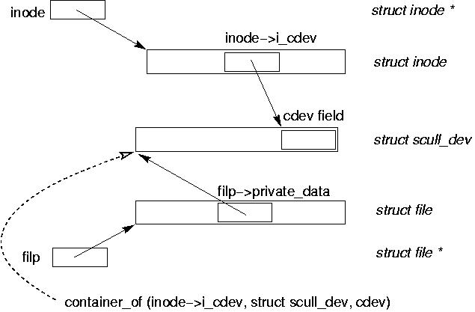
The open Method

Slide 43
The release Method
Deallocate filp->private_data
Shut down the device on last close
One release call per open
Potentially multiple close calls per open due to fork/dup
scull has no hardware to shut down
int scull_release(struct inode *inode, struct file *filp) {
return 0;
}

Slide 44
Scull Memory

Slide 45
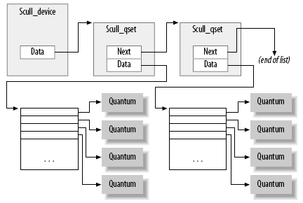
scull’s Memory Usage
struct scull_qset {
void **data;
struct scull_qset *next;
};
SCULL_QUANTUM = 1KB
Quantum set, SCULL_QSET = 1K quanta

Slide 46
scull’s Memory Usage
Dynamically allocated
#include <linux/slab.h>
void *kmalloc(size_t size, int flags);
Allocate size bytes of memory
For now, always use GFP_KERNEL
Return a pointer to the allocated memory, or NULL if the allocation fails
void kfree(void *ptr);

Slide 47
scull’s Memory Usage
int scull_trim(struct scull_dev *dev) {
struct scull_qset *next, *dptr;
int qset = dev->qset; /* dev is not NULL */
int i;
for (dptr = dev->data; dptr; dptr = next) {
if (dptr->data) {
for (i = 0; i < qset; i++) kfree(dptr->data[i]);
kfree(dptr->data);
dptr->data = NULL;
}
next = dptr->next;
kfree(dptr);
}
dev->size = 0; dev->data = NULL;
dev->quantum = scull_quantum; dev->qset = scull_qset;
return 0;
}

Slide 48
Race Condition Protection
Different processes may try to execute operations on the same scull device concurrently
There would be trouble if both were able to access the data of the same device at once
scull avoids this using a per-device mutex
All operations that touch the device’s data need to lock the mutex

Slide 49
Race Condition Protection
Some mutex usage rules
No double locking
No double unlocking
Always lock at start of critical section
Don’t release until end of critical section
Don’t forget to release before exiting
return, break, or goto
If you need to hold two locks at once, lock them in a well-known order, unlock them in the reverse order (e.g., lock1, lock2, unlock2, unlock1)

Slide 50
Mutex Usage Examples
Initialization
mutex_init(&scull_devices[i].mutex);
Critial section
if (mutex_lock_interruptible(&dev->mutex))
return –ERESTARTSYS;
scull_trim(dev); /* ignore errors */
mutex_unlock(&dev->mutex);

Slide 51
Mutex vs. Spinlock
Mutex may block
Calling process is blocked until the lock is released
Spinlock may spin (loop)
Calling processor spins until the lock is released
Never call “lock” unless it is OK for the current thread to block
Do not call “lock” while holding a spinlock
Do not call “lock” within an interrupt handler

Slide 52
Read and Write

Slide 53
read and write
Kernel memory is locked into real memory so it is always resident
User memory may have pages that are not resident
If kernel attempts to access user pages there may be a page fault
Causes the faulting process to be blocked until the page is fetched

Slide 54
read and write
ssize_t (*read) (struct file *filp, char __user *buff,
size_t count, loff_t *offp);
ssize_t (*write) (struct file *filp, const char __user *buff,
size_t count, loff_t *offp);
filp: file pointer
buff: a user-space pointer
May not be valid in kernel mode
Could be malicious
Might be swapped out
count: size of requested transfer
offp: file position pointer

Slide 55
read and write
To safely access user-space buffer
Use kernel-provided functions
#include <linux/uaccess.h>
unsigned long copy_to_user(void __user *to,
const void *from,
unsigned long count);
unsigned long copy_from_user(void *to,
const void __user *from,
unsigned long count);
Check whether the user-space pointer is valid
Return the amount of memory still to be copied

Slide 56
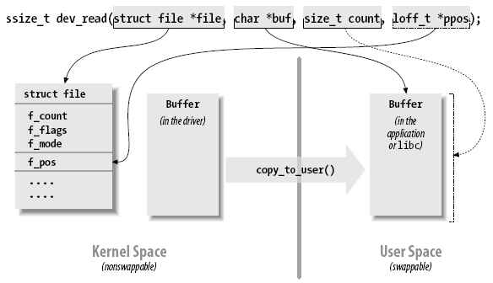
read and write

Slide 57
The read Method
Return values
Equals to the count argument, we are done
Positive < count, retry
0, end-of-file
Negative, check <linux/errno.h>
Common errors
-EINTR (interrupted system call)
-EFAULT (bad address)
May block
No data, but will arrive later
if (filp->f_flags & O_NONBLOCK) [pipe.c]
May be interrupted (e.g., signal)

Slide 58
The read Method
Each scull_read deals only with a single data quantum
I/O library may reiterate the call to read additional data
If read position > device size, return 0 (end-of-file)

Slide 59
The read Method
ssize_t scull_read(struct file *filp, char __user *buf, size_t count,
loff_t *f_pos)
{
struct scull_dev *dev = filp->private_data;
struct scull_qset *dptr; /* the first listitem */
int quantum = dev->quantum, qset = dev->qset;
int itemsize = quantum * qset; /* how many bytes in the listitem */
int item, s_pos, q_pos, rest;
ssize_t retval = 0;
if (mutex_lock_interruptible(&dev->mutex))
return -ERESTARTSYS;
if (*f_pos >= dev->size)
goto out;
if (*f_pos + count > dev->size)
count = dev->size - *f_pos;

Slide 60
The read Method
/* find listitem, qset index, and offset in the quantum */
item = (long)*f_pos / itemsize;
rest = (long)*f_pos % itemsize;
s_pos = rest / quantum; q_pos = rest % quantum;
/* follow the list up to the right position (defined elsewhere) */
dptr = scull_follow(dev, item);
if (dptr == NULL || !dptr->data || ! dptr->data[s_pos])
goto out; /* don't fill holes */
/* read only up to the end of this quantum */
if (count > quantum - q_pos)
count = quantum - q_pos;

Slide 61
The read Method
if (copy_to_user(buf, dptr->data[s_pos] + q_pos, count)) {
retval = -EFAULT;
goto out;
}
*f_pos += count;
retval = count;
out:
mutex_unlock(&dev->mutex);
return retval;
}

Slide 62
Playing with the New Devices
With open, release, read, and write, a driver can be compiled and tested
Use free command to see the memory usage of scull
Use strace to monitor various system calls and return values
strace ls –l > /dev/scull0 to see quantized reads and writes

